Slide 1
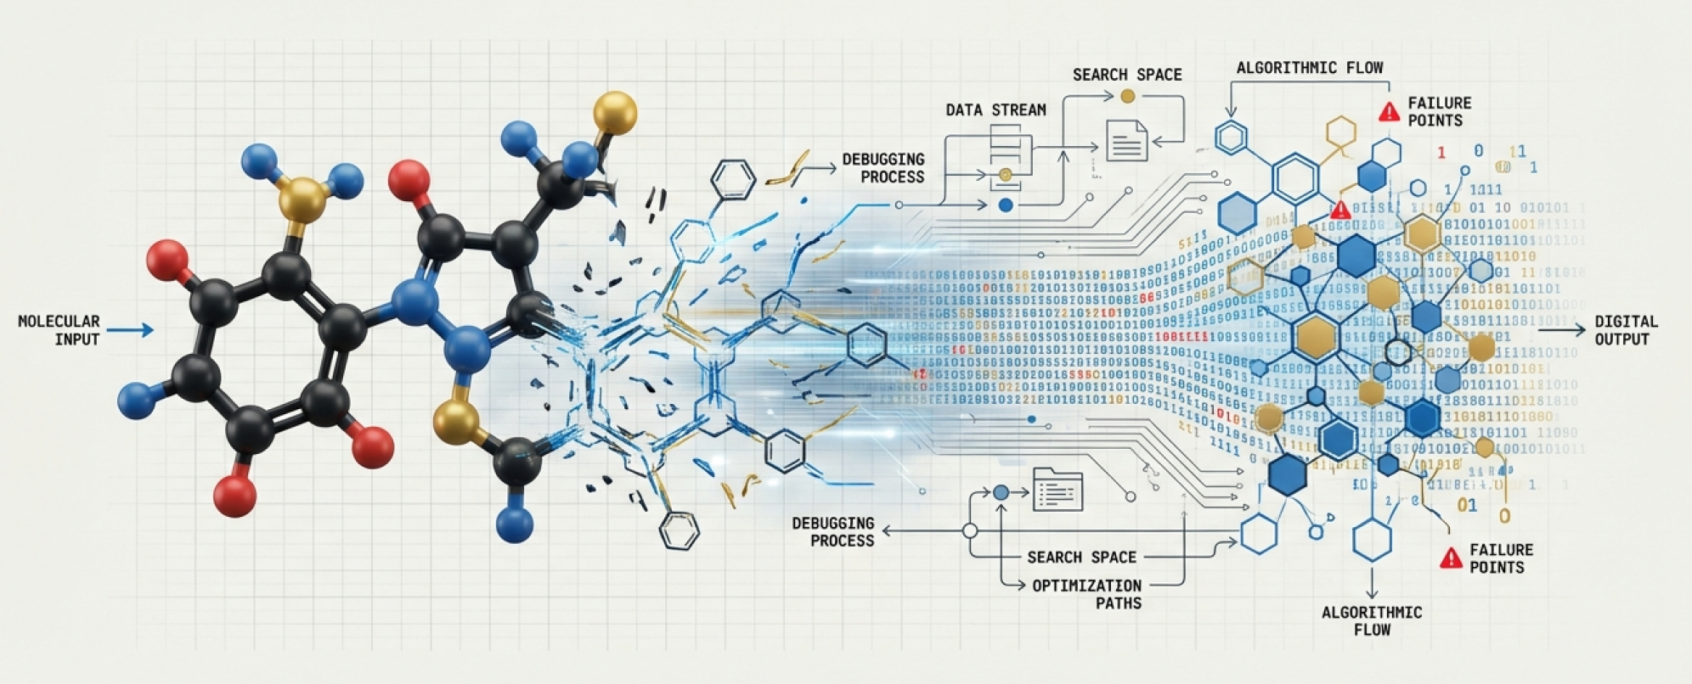

From ligands to drugs
Paweł Dąbrowski-Tumański
MiNI Lecture, Still Winter 2026

Slide 2








BINDER VS DRUG
💊 Not every ligand is a drug
🔗 Binding is only the first requirement
🧠 Drugs must function in complex biological systems

Slide 3
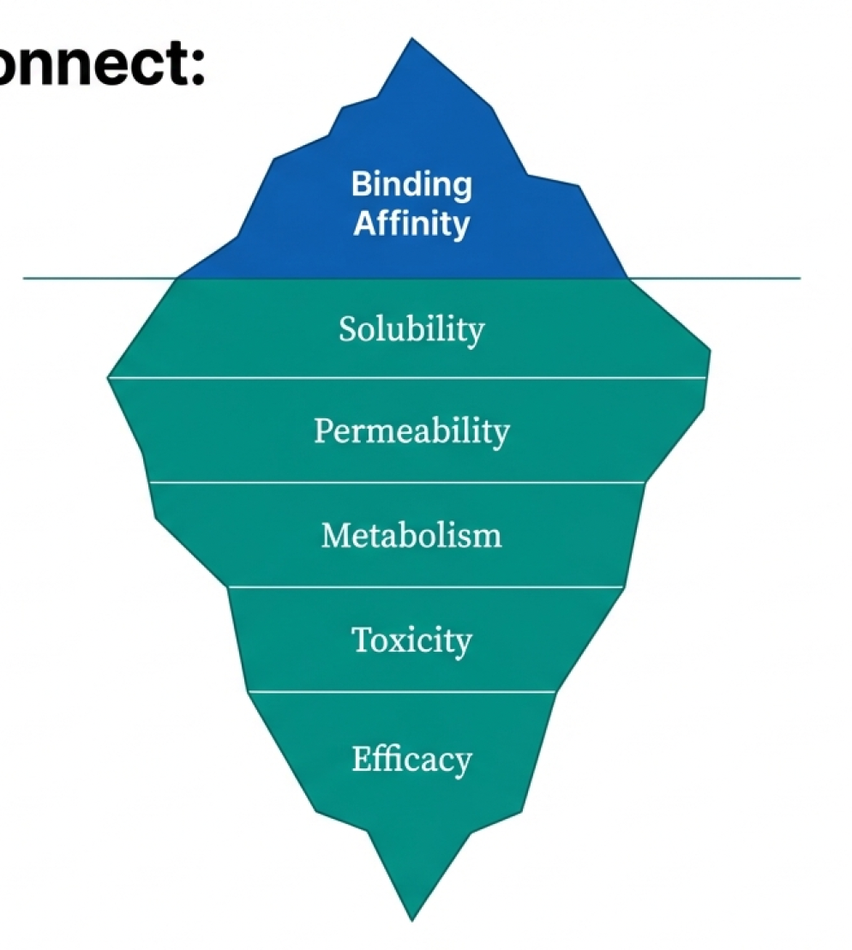
WHY MOST GOOD BINDERS FAIL
❌ Poor solubility or permeability
🧬 Rapid metabolism or toxic metabolites
⚠️ Off-target effects dominate outcomes

Slide 4
DRUG DISCOVERY AS A SYSTEMS PROBLEM
🕸️ Multiple interacting biological subsystems
📉 Local optimization often fails globally
🧩 Single-target thinking is insufficient

Slide 5
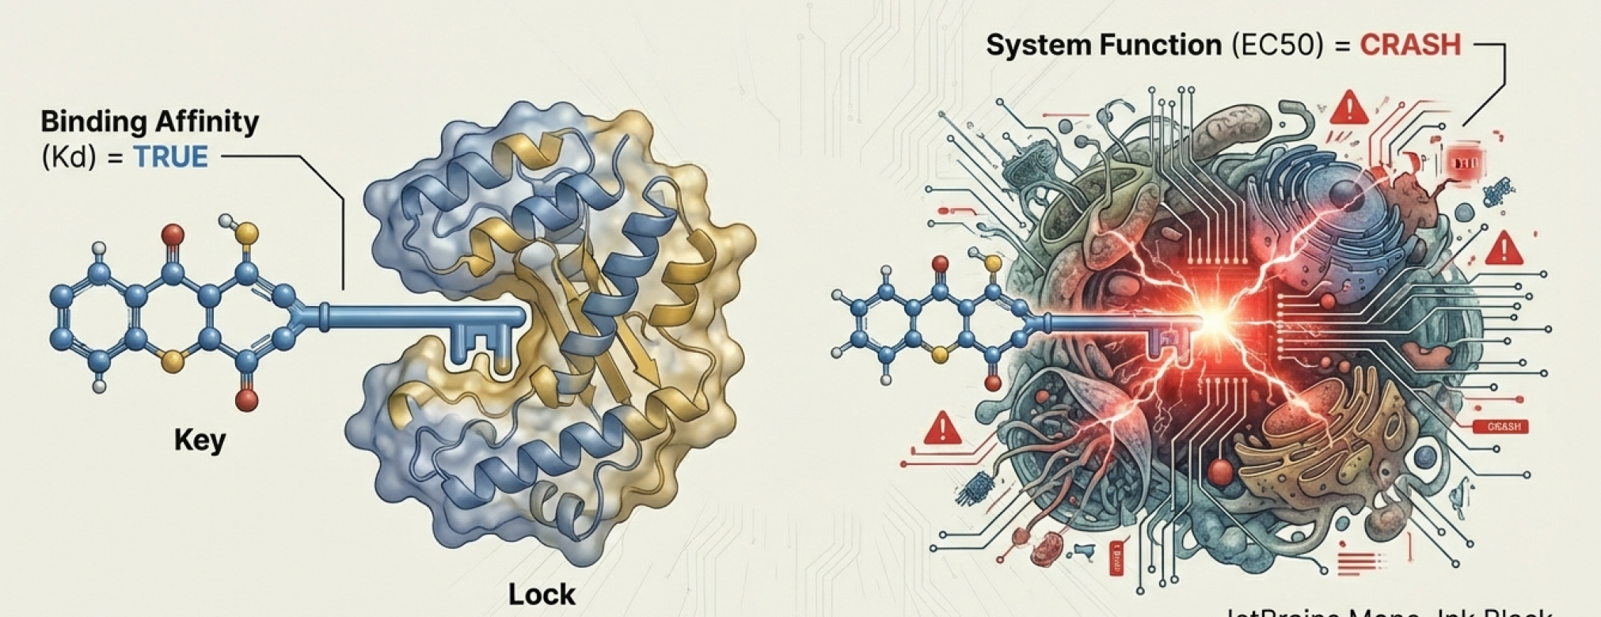
BINDING – NECESSARY, NOT SUFFICIENT
🔒 Binding does not guarantee efficacy
⏱️ Kinetics and exposure matter
📊 Functional response ≠ binding affinity

Slide 6
THE HUMAN BODY AS ENVIRONMENT
🧪 Enzymes actively modify molecules
🚧 Biological barriers restrict access
🗑️ Efficient clearance removes compounds

Slide 7
MULTI-OBJECTIVE OPTIMIZATION
⚖️ Potency vs safety vs bioavailability
📐 No single “best” molecule exists
📈 Trade-offs define real drug candidates

Slide 8
WHERE COMPUTATION HELPS
🤖 Models guide exploration, not decisions
🧠 Biology remains noisy and uncertain
🔍 Understanding limits is essential

Slide 9


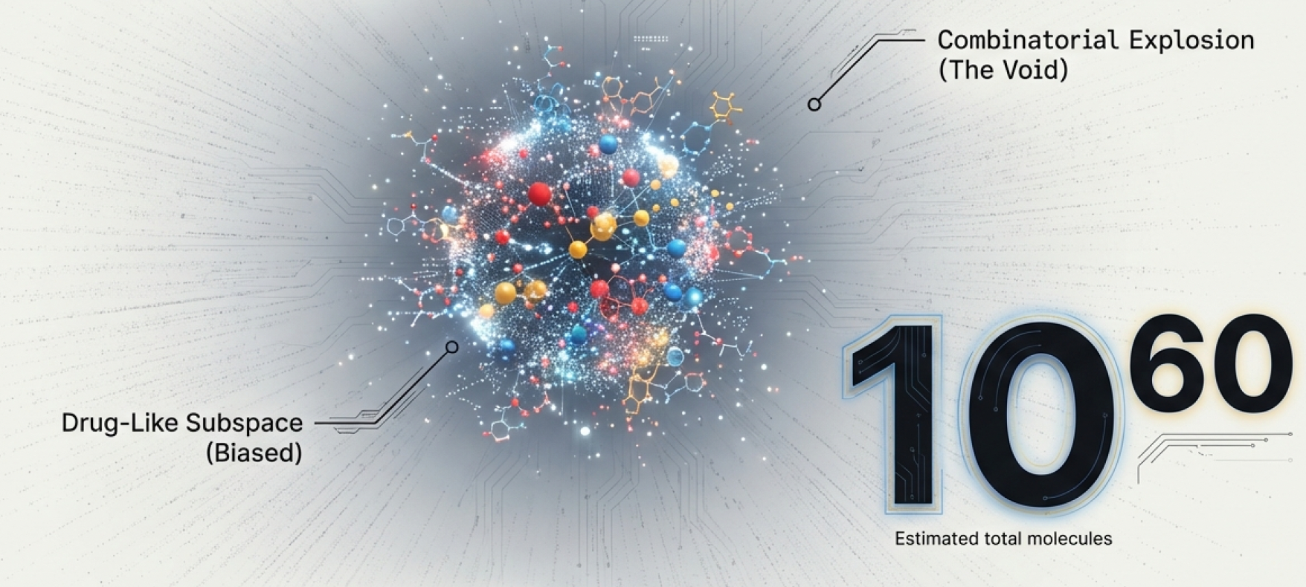
CHEMICAL SPACE: VAST BUT STRUCTURED

Slide 10
CHEMICAL SPACE: VAST BUT STRUCTURED
🌌 The number of possible molecules is astronomically large
🧭 Biology restricts useful regions of chemical space
🔍 Drug discovery is guided search, not random sampling

Slide 11
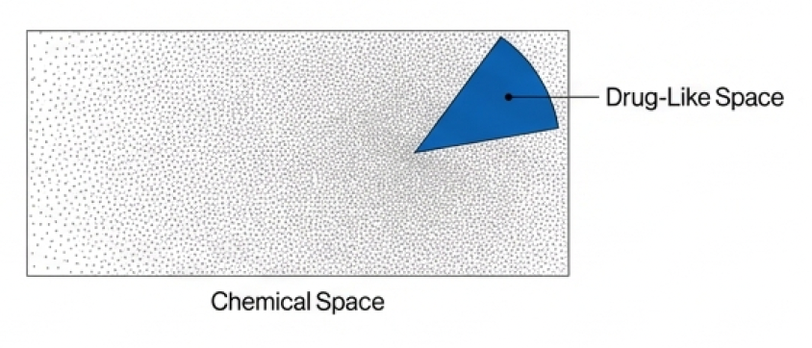
DRUGS VS ARBITRARY MOLECULES
💊 Drugs occupy a small, biased subspace
📏 Physicochemical constraints limit candidates
🚫 Most molecules are biologically irrelevant

Slide 12
VIRTUAL SCREENING
🧪 Computational screening proposes candidates
❓ Predictions generate hypotheses, not answers
🔄 Experiments validate and refine models

Slide 13
SIMILARITY SEARCH FOR KNOWN DRUGS
🧬 Similar molecules often share biological effects
📐 Similarity depends on representation choice
⚠️ Novel mechanisms may be missed

Slide 14
SUBSTRUCTURE SEARCH
🧩 Functional motifs drive activity
🔗 Substructure queries capture key interactions
🧠 Pharmacophores abstract chemistry into patterns

Slide 15
EXACT VS APPROXIMATE SEARCH
🎯 Exact search ensures correctness
⚡ Approximate search enables scalability
📉 Speed–accuracy trade-offs are unavoidable

Slide 16
ALGORITHMIC SCALING CHALLENGES
📈 Chemical libraries grow rapidly
💾 Memory and compute become bottlenecks
🧠 Indexing and heuristics are essential

Slide 17
WHY RANKING MATTERS MORE
🏆 Only top candidates are experimentally tested
🧪 Practical focus is on prioritization
📊 Precision-at-top-k dominates utility

Slide 18
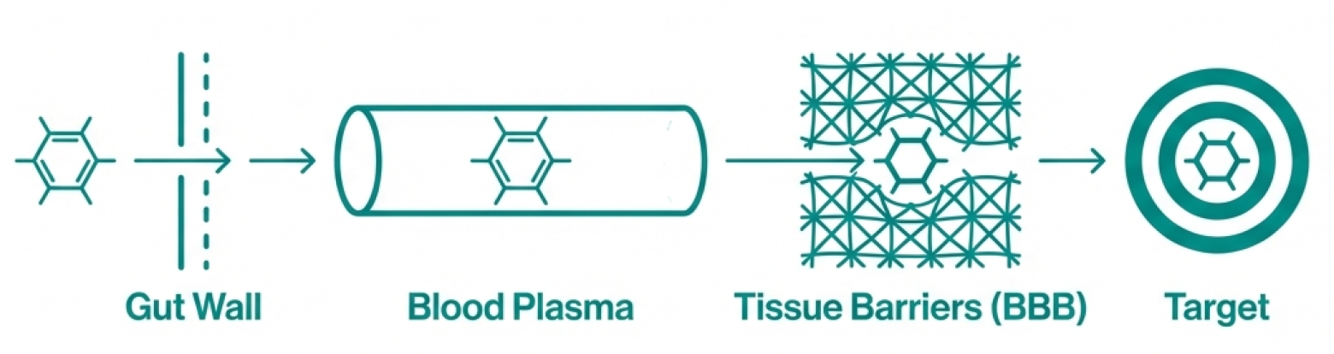

ADME AS A BIOLOGICAL FILTER
🚦 ADME determines whether a drug reaches its target
🧬 Many binders fail before exerting any effect

Slide 19
ABSORPTION
💧 Poor solubility limits bioavailability
🚪 Membrane permeability controls uptake
📐 Simple descriptors give rough predictions

Slide 20
DISTRIBUTION
🩸 Plasma protein binding reduces free drug
🧠 Barriers restrict access to organs
📊 Distribution shapes effective concentration

Slide 21
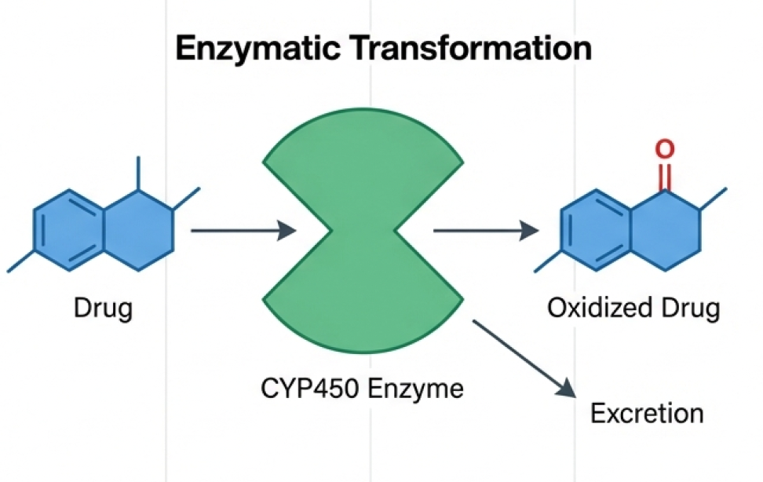
METABOLISM
🧪 Enzymes chemically modify drug molecules
⚙️ Can activate, deactivate, or toxify compounds
📉 Fast metabolism reduces exposure

Slide 22
EXCRETION
🗑️ Kidneys and liver eliminate compounds
⏱️ Clearance determines drug lifetime
📉 High clearance limits therapeutic effect

Slide 23
WHY ADME KILLS MOST DRUG CANDIDATES
❌ Majority of failures occur before efficacy
📊 ADME dominates attrition statistics
🧠 Early prediction saves time and cost

Slide 24
RULE-BASED VS ML-BASED ADME
📏 Rules encode chemical intuition
🤖 ML captures nonlinear patterns
⚠️ Both rely on biased historical data

Slide 25
UNCERTAINTY AND NOISE
📉 Experimental labels are noisy
🔀 Assay conditions vary widely
🧠 Confidence estimates are often missing

Slide 26
DRUG METABOLISM AS INTERACTION
🧬 Metabolism driven by enzyme–ligand binding
⚙️ Drugs behave as enzyme substrates
🔄 Chemical structure determines fate

Slide 27
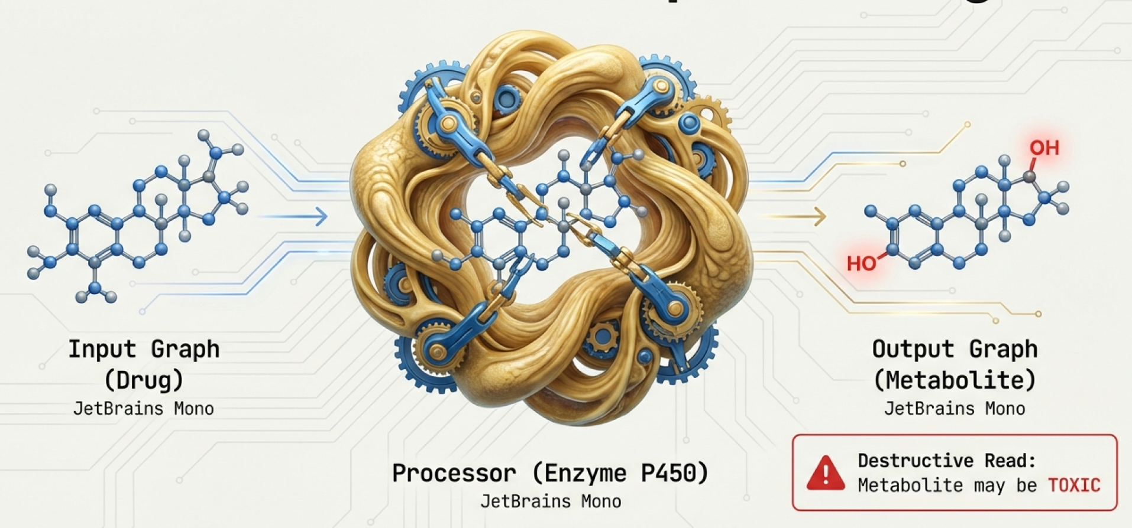
PHASE I METABOLISM: FUNCTIONALIZATION
🧪 Oxidation, reduction, hydrolysis
🔥 Dominated by cytochrome P450 enzymes
📉 Introduces reactive or polar groups

Slide 28
PHASE II METABOLISM: CONJUGATION
➕ Addition of polar moieties
🚚 Facilitates excretion
🔗 Often terminates activity

Slide 29
ACTIVE VS INACTIVE METABOLITES
💊 Some metabolites remain biologically active
⚠️ Others cause toxicity
🧠 Parent compound is not the whole story

Slide 30
TOXIC METABOLITES AND SAFETY FAILURES
☠️ Reactive intermediates damage tissues
🧬 Often detected late in development
📉 Major cause of clinical failure

Slide 31
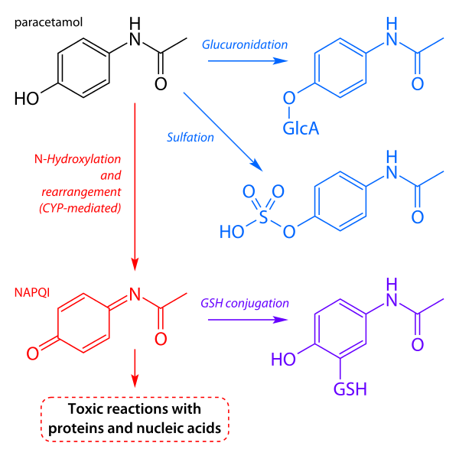
TOXIC METABOLITES AND SAFETY FAILURES
☠️ Paracetamol in large dosage is toxic
☠️ Likewise in cases, when the main metabolism is impaired

Slide 32
PREDICTING METABOLIC HOTSPOTS
🎯 Certain atoms preferentially modified
📐 Substructure-based heuristics
🤖 ML predicts likelihood, not certainty

Slide 33
REACTION TEMPLATES
AllChem.ReactionFromSmarts( '[#6:1][O:2]>>[#6:1]=[O:2]')
⚙️ ”Take carbon (label 1) connected to oxygen (label 2) and make the bond between them double

Slide 34
REACTION TEMPLATES
🔗 Metabolism as graph rewriting
🧩 Reaction rules approximate enzyme action
⚙️ Enables in silico metabolite generation

Slide 35
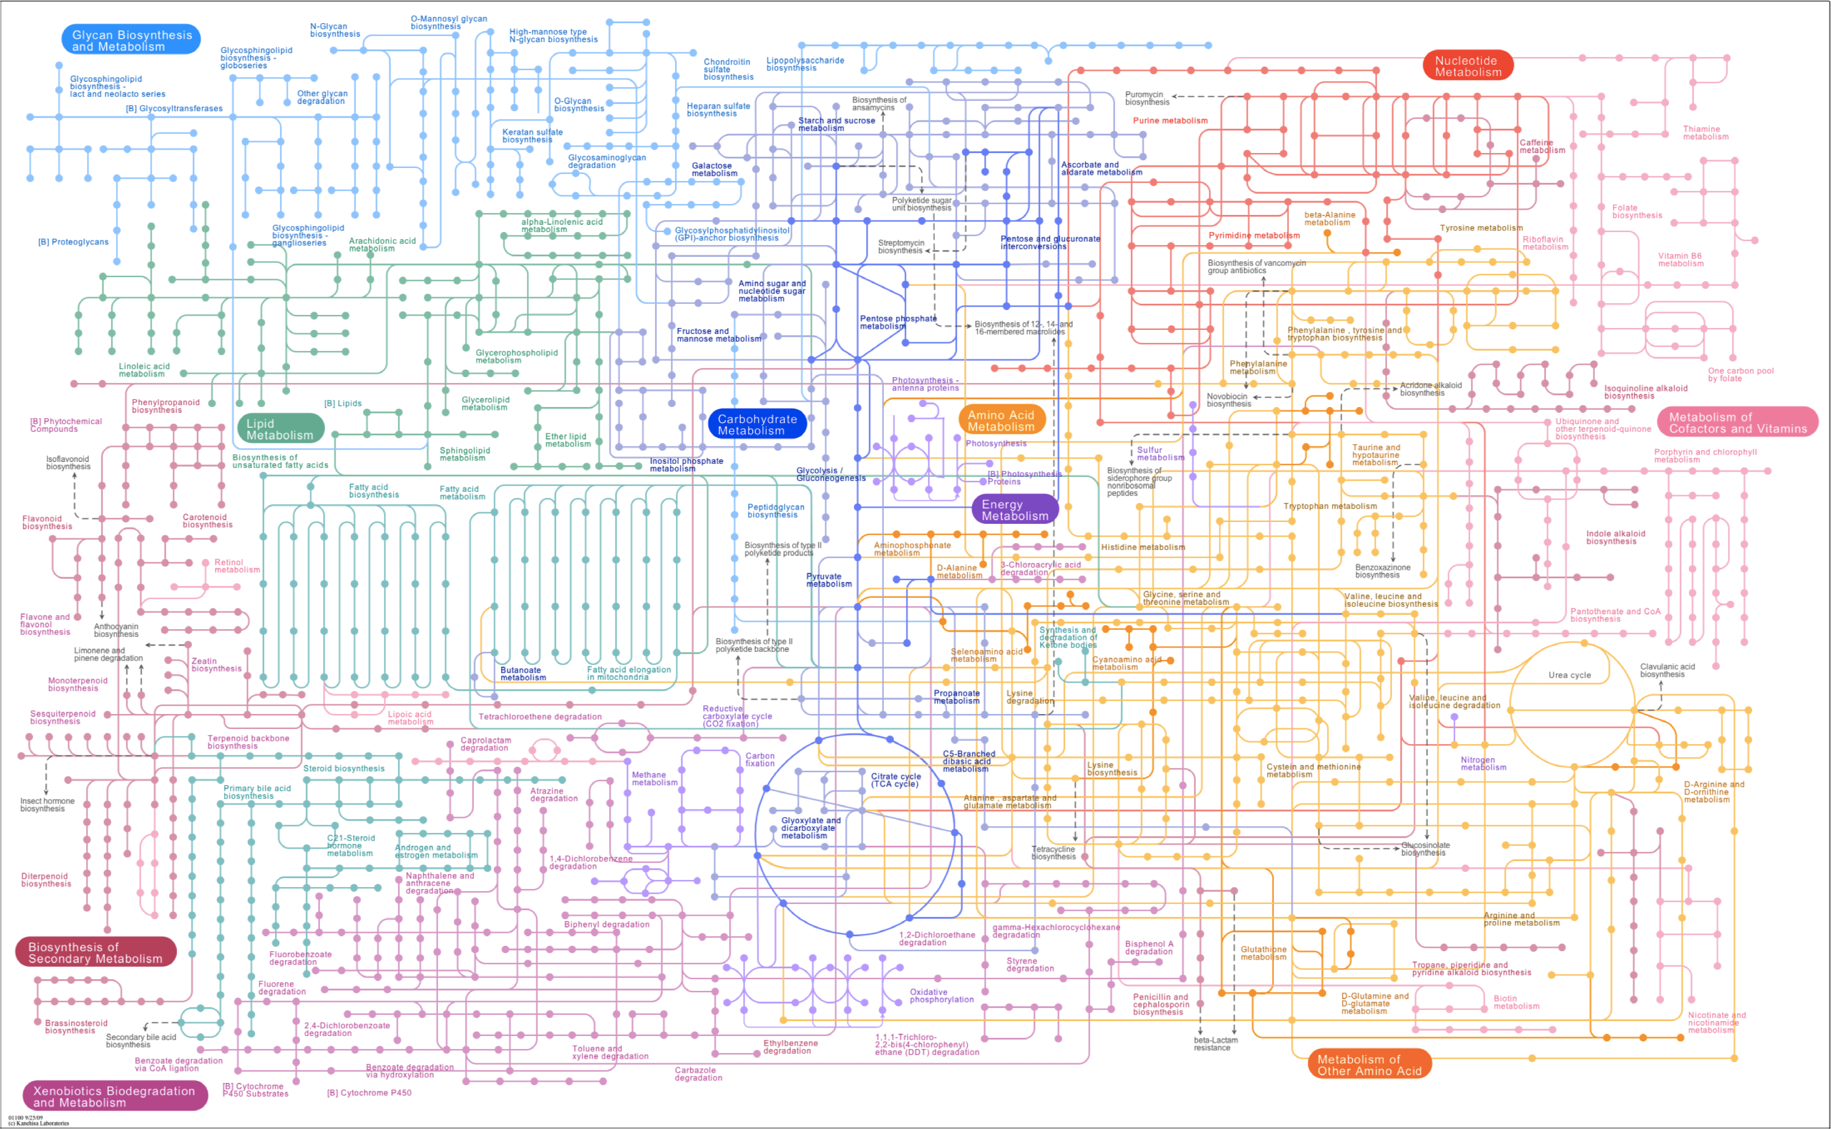
METABOLISM AS GRAPH

Slide 36
ENZYME PROMISCUITY
🔀 Enzymes act on many substrates
📉 Specificity is probabilistic
🧠 Limits predictive accuracy

Slide 37
BINDING VS EFFECT
🔗 Binding does not guarantee response
📊 Functional effect depends on signaling
🧠 Biology transforms molecular events

Slide 38
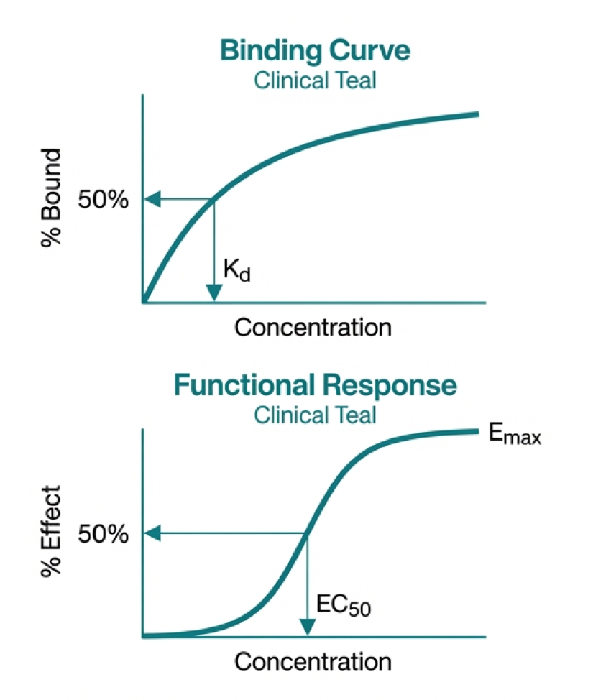
DOSE–RESPONSE CURVES
📈 Effect increases with concentration
⚖️ Nonlinear biological responses
🧪 Central pharmacological concept

Slide 39
EC50, EMAX, AND FUNCTIONAL POTENCY
🎯 EC50 measures sensitivity
📊 Emax measures maximal effect
🔍 Distinct from binding affinity

Slide 40
PARTIAL AGONISTS AND ANTAGONISTS
⚖️ Partial agonists activate incompletely
🚫 Antagonists block receptor function
🧠 Functional diversity despite binding

Slide 41
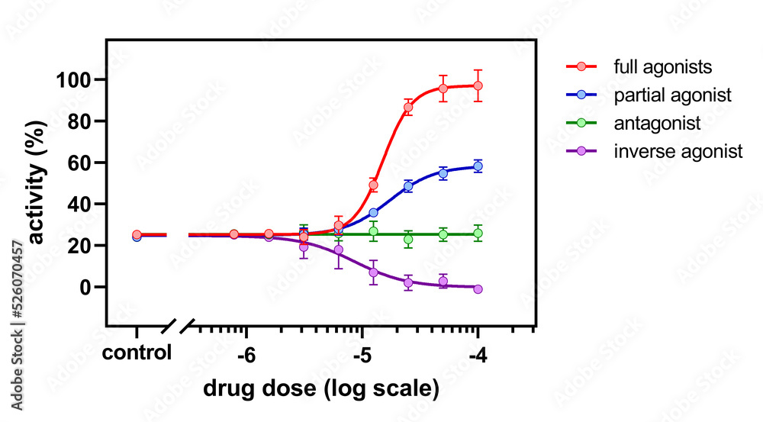
PARTIAL AGONISTS AND ANTAGONISTS
⚖️ Partial agonists activate incompletely
🚫 Antagonists block receptor function
🧠 Functional diversity despite binding

Slide 42
TIME DEPENDENCE OF DRUG ACTION
⏱️ Delayed onset and long-lasting effects
📉 Accumulation and tolerance
🧮 Dynamics beyond static measures

Slide 43
KD VS EC50: WHY THEY DIFFER
🔗 Kd reflects binding thermodynamics
📊 EC50 reflects system-level response
🧠 Context separates the two

Slide 44
MODELING DRUG RESPONSE
📐 Mathematical models simplify biology
🔄 Feedback introduces nonlinearity
🧠 Useful abstractions, not full reality

Slide 45

ONE DRUG, MANY TARGETS
🎯 Drugs rarely interact with a single protein
🔀 Molecular similarity drives multi-target binding
🧠 Polypharmacology is the rule, not the exception

Slide 46
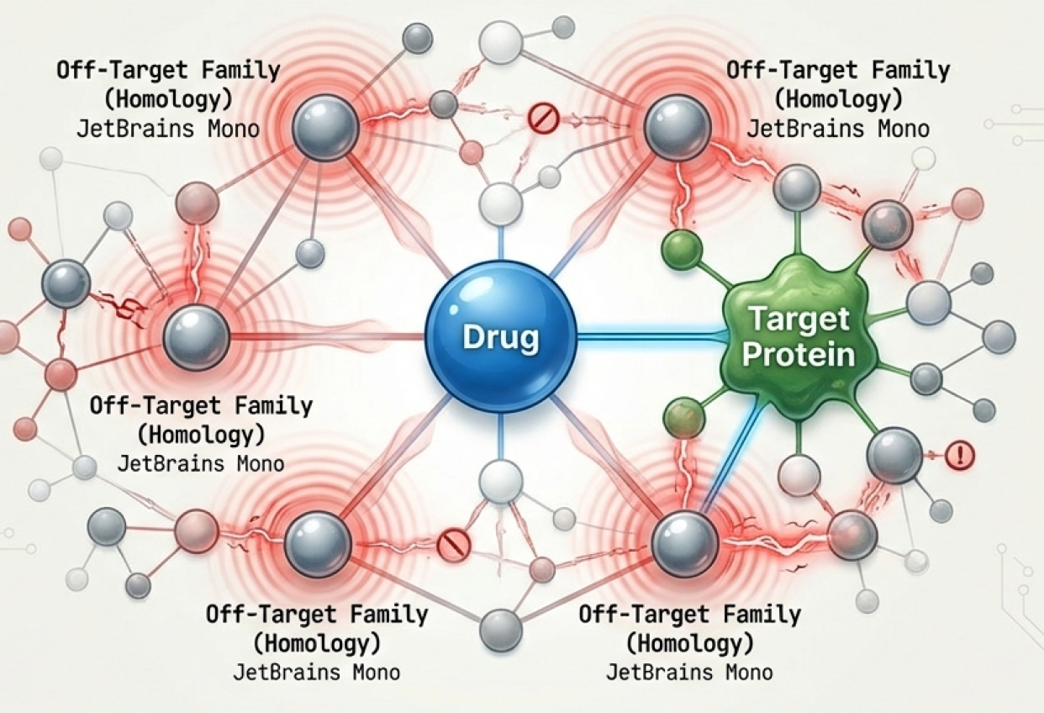
OFF-TARGET BINDING AND SIDE EFFECTS
⚠️ Unintended targets cause adverse effects
🧬 Off-targets often belong to protein families
📉 Side effects limit therapeutic window

Slide 47
BENEFICIAL POLYPHARMACOLOGY
💡 Multiple targets can enhance efficacy
🧠 Common in cancer and CNS therapies
🕸️ Desired effects may be network-level

Slide 48
DRUGS AS NETWORK PERTURBATIONS
🕸️ Targets are embedded in biological networks
📈 Small molecular effects can propagate
🧠 Systems biology explains emergent responses

Slide 49
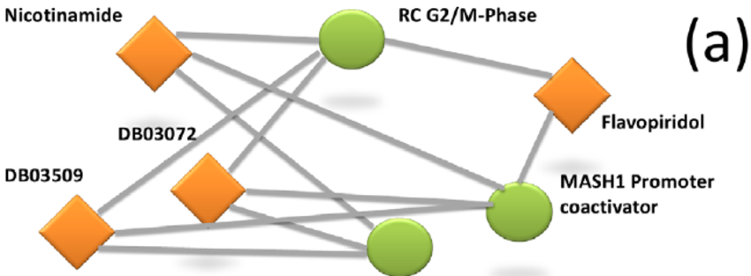
DRUG–TARGET INTERACTION NETWORKS
🔗 Bipartite graphs of drugs and proteins
📊 Enable global reasoning about drug action

Slide 50
PROTEIN FAMILIES
🧬 Homologous proteins share binding sites
🔀 Ligands often bind entire protein families
📐 Family-aware models improve predictions

Slide 51
NETWORK-BASED DRUG REPOSITIONING
🔄 Existing drugs for new diseases
🧠 Network proximity suggests new indications
💊 Faster and cheaper than de novo discovery

Slide 52
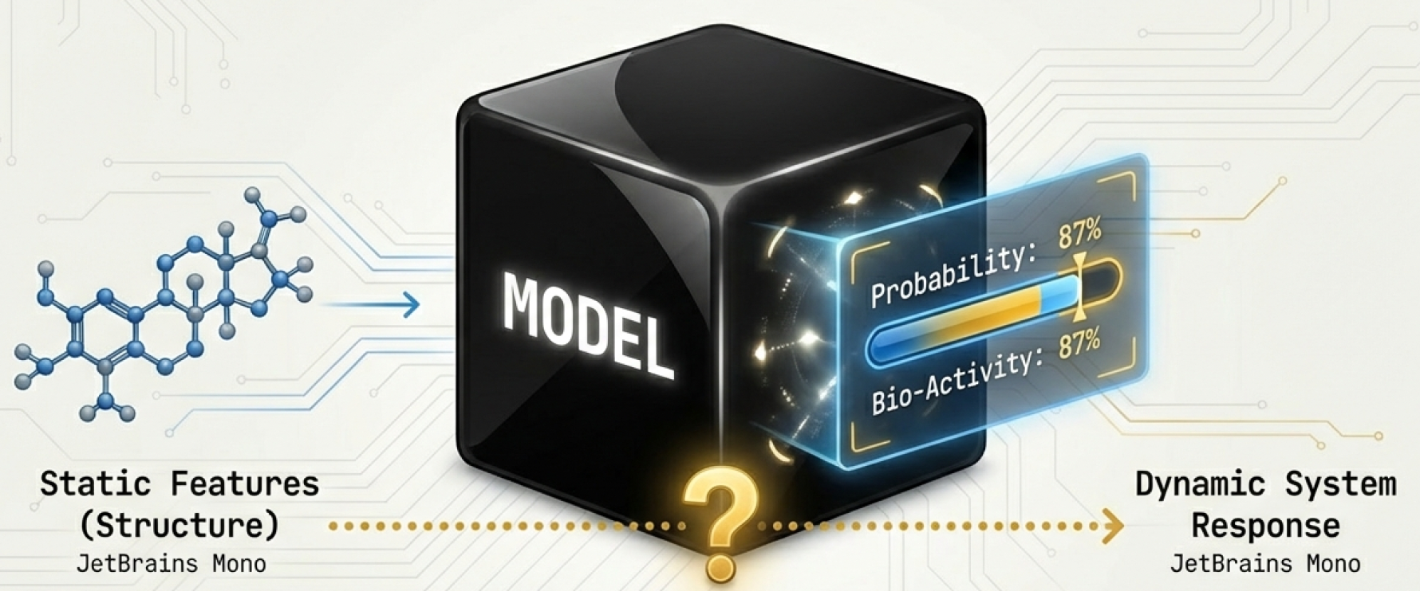

QSAR REVISITED
🤖 QSAR models predict biological effects, not chemistry
🧪 Labels reflect experimental assays
⚠️ Correlation does not imply causation

Slide 53
FEATURE-BASED VS GRAPH-BASED MODELS
📐 Feature models rely on human-designed descriptors
🧬 Graph models learn representations from structure
⚖️ Expressivity vs interpretability trade-off

Slide 54
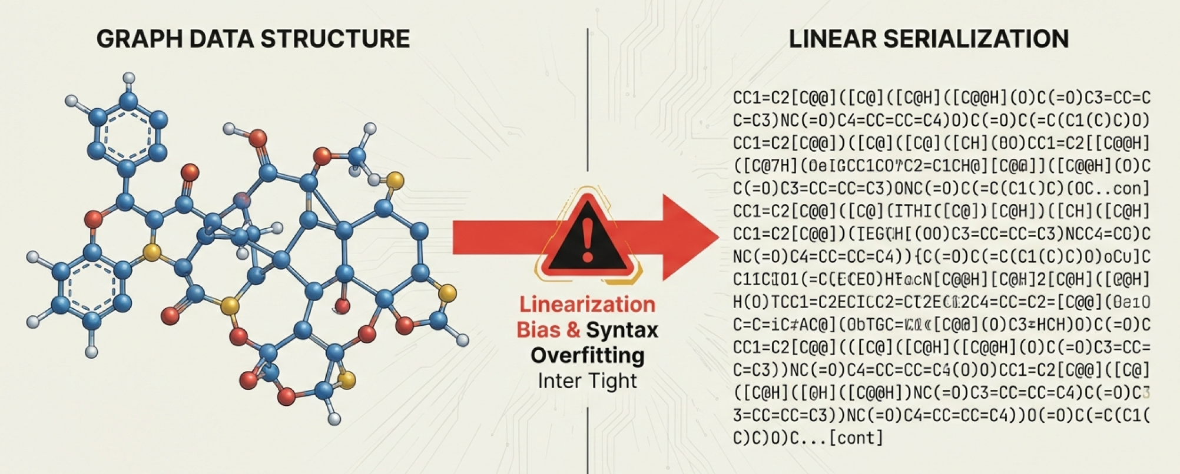
SMILES MODELS AND REPRESENTATION BIAS
🔤 SMILES impose arbitrary linearization

Slide 55
SMILES MODELS AND REPRESENTATION BIAS
🔤 SMILES impose arbitrary linearization
🧠 Models learn syntax as well as chemistry
⚠️ Different SMILES encode same molecule

Slide 56
DATA LEAKAGE IN DRUG DATASETS
🚨 Information leaks across train and test sets
🧬 Near-duplicate molecules inflate performance
📉 Leads to unrealistic expectations

Slide 57
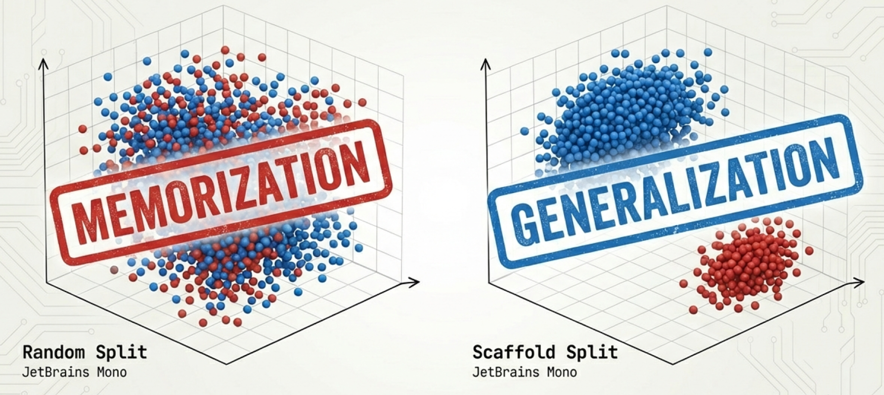
SCAFFOLD BIAS AND MEMORIZATION
🧩 Models memorize chemical scaffolds
📊 High accuracy without true generalization
🧠 Chemistry series dominate datasets

Slide 58
WHY RANDOM SPLITS LIE
🎲 Random splits preserve scaffold similarity
🧪 Test data is too similar to training
⚠️ Performance collapses in realistic settings

Slide 59
PERFORMANCE VS CLINICAL REALITY
🏆 Leaderboards reward narrow improvements
🏥 Clinical success requires robustness
🧠 Metrics rarely reflect real-world use

Slide 60
CHEMICAL SPACE SHIFT IN PRACTICE
📦 New projects explore unseen chemistry
🔀 Training and deployment distributions differ
📉 Model performance degrades silently

Slide 61
ASSAY CONDITIONS VS REAL BIOLOGY
🧪 Assays simplify biological reality
⚗️ In vitro ≠ in vivo
🧠 Context dependence breaks models

Slide 62
TEMPORAL VS RANDOM VALIDATION
⏳ Temporal splits mimic real deployment
🎲 Random splits inflate optimism
📊 Time-aware evaluation is harder but honest

Slide 63
SHORTCUT LEARNING
🧠 Models exploit dataset-specific artifacts
📐 Easy signals replace true understanding
⚠️ High accuracy hides wrong reasoning

Slide 64
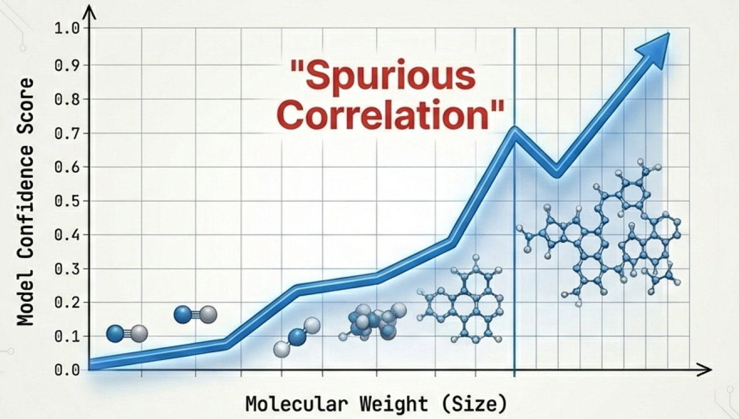
WHEN MODELS LEARN SIZE
📏 Molecular weight correlates with activity
⚖️ Bigger molecules often score better
🧠 Spurious correlations dominate predictions

Slide 65
DETECTING AND DIAGNOSING
🔍 Out-of-distribution detection
📉 Performance stratified by scaffold
🧠 Stress-testing with adversarial molecules

Slide 66
FULLY AUTOMATED DRUG DISCOVERY
🤖 Models lack biological common sense
🧠 Humans integrate incomplete information
⚠️ Automation without oversight is risky

Slide 67
EXPERT INTUITION AND VISUAL INSPECTION
👁️ Chemists inspect structures and interactions
🧩 Pattern recognition beyond algorithms
🧠 Experience guides decision-making

Slide 68
HUMAN BIASES AND MODEL BIASES
⚖️ Humans and models share blind spots
🔁 Biases can reinforce each other
🧠 Awareness improves outcomes

Slide 69
ACTIVE LEARNING
🎯 Select experiments to maximize information
⚖️ Balance exploration and exploitation
🤖 Models guide experimental design

Slide 70
EXPLORATION VS EXPLOITATION
🧭 Explore new chemical space
🔁 Exploit known active regions
🧠 Strategic trade-offs drive progress

Slide 71
INTERACTIVE MODEL-GUIDED DESIGN
🖥️ Humans interact with model suggestions
🔄 Iterative design–test cycles
💡 Collaboration outperforms automation

Slide 72
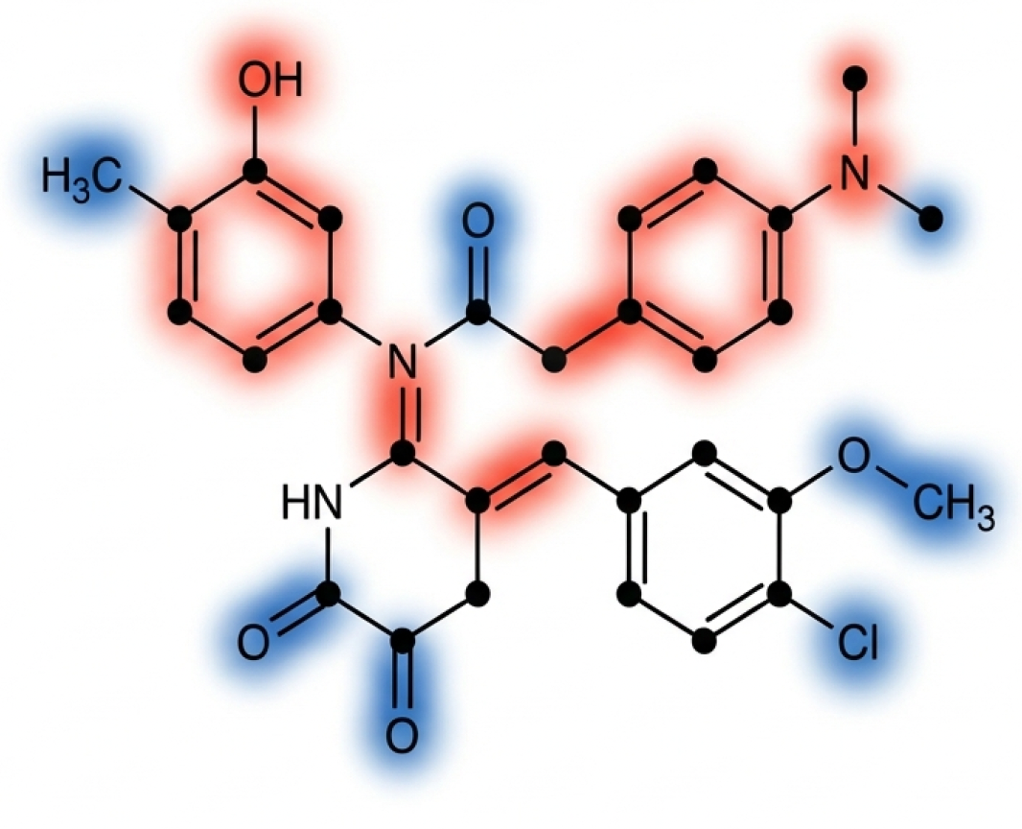

WHY CHEMISTS DON’T TRUST BLACK BOXES
🧩 Complex models are opaque
⚠️ Lack of interpretability hinders adoption
🧠 Trust requires understanding predictions

Slide 73
WHAT DOES MODEL EXPLAINABILITY MEAN?
🔍 Highlighting features driving predictions
🧬 Understanding molecular contributions
⚖️ Balancing fidelity with simplicity

Slide 74
FEATURE ATTRIBUTION FOR MOLECULES
📊 Quantifying importance of atoms or fragments
🖋️ Visualizing contributions to activity
🧠 Supports rational design decisions

Slide 75
FRAGMENT IMPORTANCE
🧩 Which molecular parts matter most?
🔄 Counterfactuals show minimal changes for effect
💡 Guides chemists in modifying structures

Slide 76
ACTIONABLE EXPLANATIONS
🎯 Insights should inform chemical modifications
🧬 Explainability links model and experiment
🔍 Supports iterative molecule optimization

Slide 77
LIMITS OF EXPLAINABILITY IN BIOLOGY
⚠️ Biology is context-dependent and noisy
🧠 Some effects cannot be fully explained
📉 Models provide guidance, not certainties

Slide 78
DRUG DISCOVERY AS RISK MANAGEMENT
⚖️ Balance efficacy, safety, cost, and time
📊 Decisions under uncertainty are critical
🧠 Quantitative models inform strategy

Slide 79
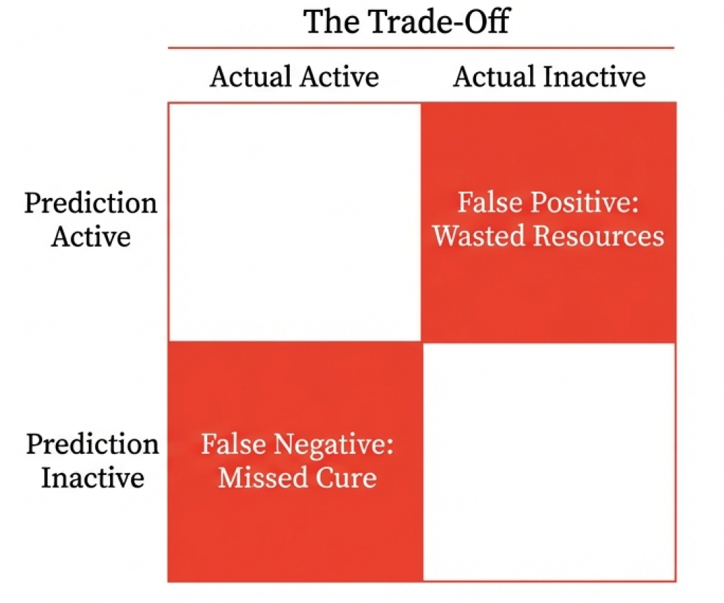
FALSE POSITIVES VS FALSE NEGATIVES
🚫 False positives waste experiments
❌ False negatives lose promising compounds
⚖️ Trade-offs depend on project priorities

Slide 80
COST OF ERRORS IN DRUG DEVELOPMENT
💰 Late-stage failures are extremely expensive
🧬 Early predictions reduce risk
🧠 Decision-theoretic thinking saves resources

Slide 81
EVALUATION METRICS THAT MATTER
📈 Focus on top candidates, not global accuracy
🎯 Precision-at-top-k reflects experimental utility
🧮 Real-world metrics differ from benchmark scores

Slide 82
PRECISION-AT-TOP-K VS ACCURACY
🔝 Top predictions drive decisions
📊 Overall accuracy can be misleading
🧠 Prioritization is key in chemistry pipelines

Slide 83
REGULATORY CONSTRAINTS AS HARD LIMITS
📜 Safety regulations constrain chemical space
⚠️ Compliance is non-negotiable
🧬 Models guide, but humans ensure legal and ethical use

Slide 84
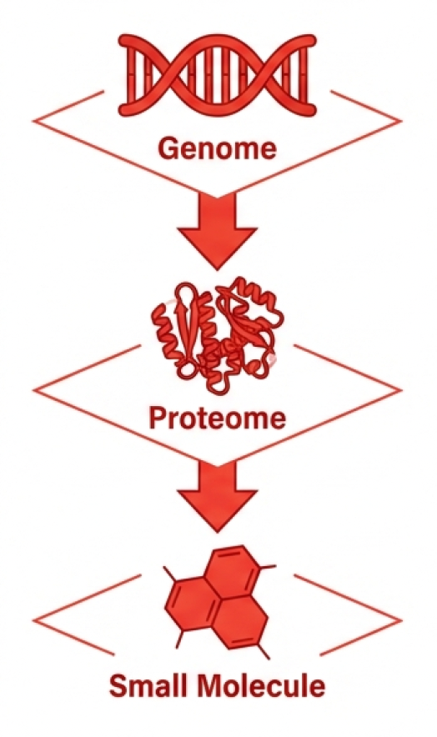

FROM GENES TO PROTEINS TO DRUGS
🧬 Gene variants determine protein targets
💊 Drugs interact at protein or pathway level
🧠 Linking genotype to drug response is central

Slide 85
LINKING OMICS DATA TO LIGANDS
🧪 Transcriptomics and proteomics reveal targets
📊 Metabolomics informs small molecule effects
🔗 Integrative data enables predictive modeling

Slide 86
PERSONALIZED MEDICINE INTUITION
🧬 Patient-specific variation affects drug efficacy
💊 Precision dosing and target selection
🧠 Bioinformatics guides individualized therapy

Slide 87
SYSTEMS-LEVEL VIEWS OF DRUG ACTION
🕸️ Drugs perturb networks, not single proteins
📊 Polypharmacology emerges at systems scale
🧠 Modeling pathways improves understanding

Slide 88
DATA INTEGRATION ACROSS SCALES
🔗 Molecular, cellular, and organismal data combined
📊 Multi-scale models enable richer predictions
🧠 Integration supports rational drug design

Slide 89
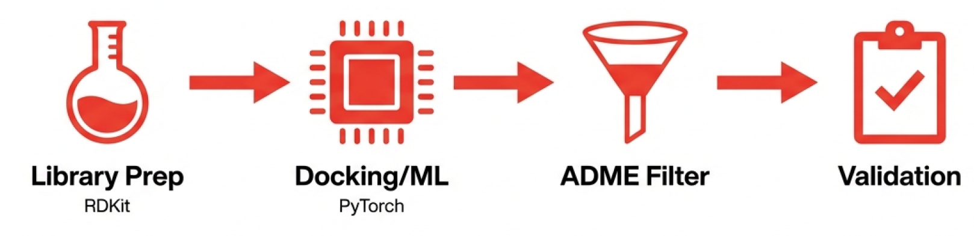
TYPICAL DRUG DISCOVERY PIPELINES
📊 Pipelines coordinate multiple software tools
🧠 Modular design aids reproducibility

Slide 90
RDKIT, ML, DOCKING, AND ADME TOOLS
🔧 RDKit for chemical manipulation
🤖 ML models for prediction
⚗️ Docking and ADME modules integrated

Slide 91
REPRODUCIBILITY CHALLENGES
🧪 Random seeds, software versions, and data preprocessing matter
📊 Pipelines must be documented
⚠️ Lack of reproducibility hampers adoption

Slide 92
WHY RESULTS DON’T TRANSFER
🧬 Assay protocols differ subtly
📊 Chemical libraries vary
⚖️ Models need context-specific validation

Slide 93
OPEN SCIENCE VS PROPRIETARY DATA
🌐 Open datasets improve reproducibility
🔒 Proprietary data limits sharing
🧠 Balance between accessibility and commercial value

Slide 94
SEARCH UNDER BIOLOGICAL CONSTRAINTS
🔍 Vast chemical space is constrained by biology
🧬 Only a small fraction of molecules are relevant
🧠 Computational methods narrow search efficiently

Slide 95
BINDING IS ONLY ONE FILTER
⚖️ ADME, toxicity, and pharmacodynamics matter too
💊 Multiple biological layers determine success
🧪 Binding alone is insufficient for a drug

Slide 96
MODELS ENCODE ASSUMPTIONS AND BIASES
🧩 Every algorithm reflects prior knowledge
⚠️ Biases affect predictions and rankings
🧠 Awareness of limitations is critical

Slide 97
INTEGRATION VS SINGLE-MODEL
🔗 Combining ML, docking, ADME, and bioinformatics
🧬 Multi-scale data improves reliability
🧠 Integrated pipelines outperform isolated models

Slide 98
MOST FAILURES ARE PREDICTABLE
📉 Many late-stage failures stem from ADME/toxicity
🧬 Early modeling can flag high-risk candidates
🧠 Predictive awareness reduces cost and time

Slide 99
COMPUTATION VS BIOLOGY
🖥️ Models provide hypotheses, not guarantees
⚖️ Experiments ultimately validate candidates
🧠 Collaboration between computation and biology is essential

Slide 100
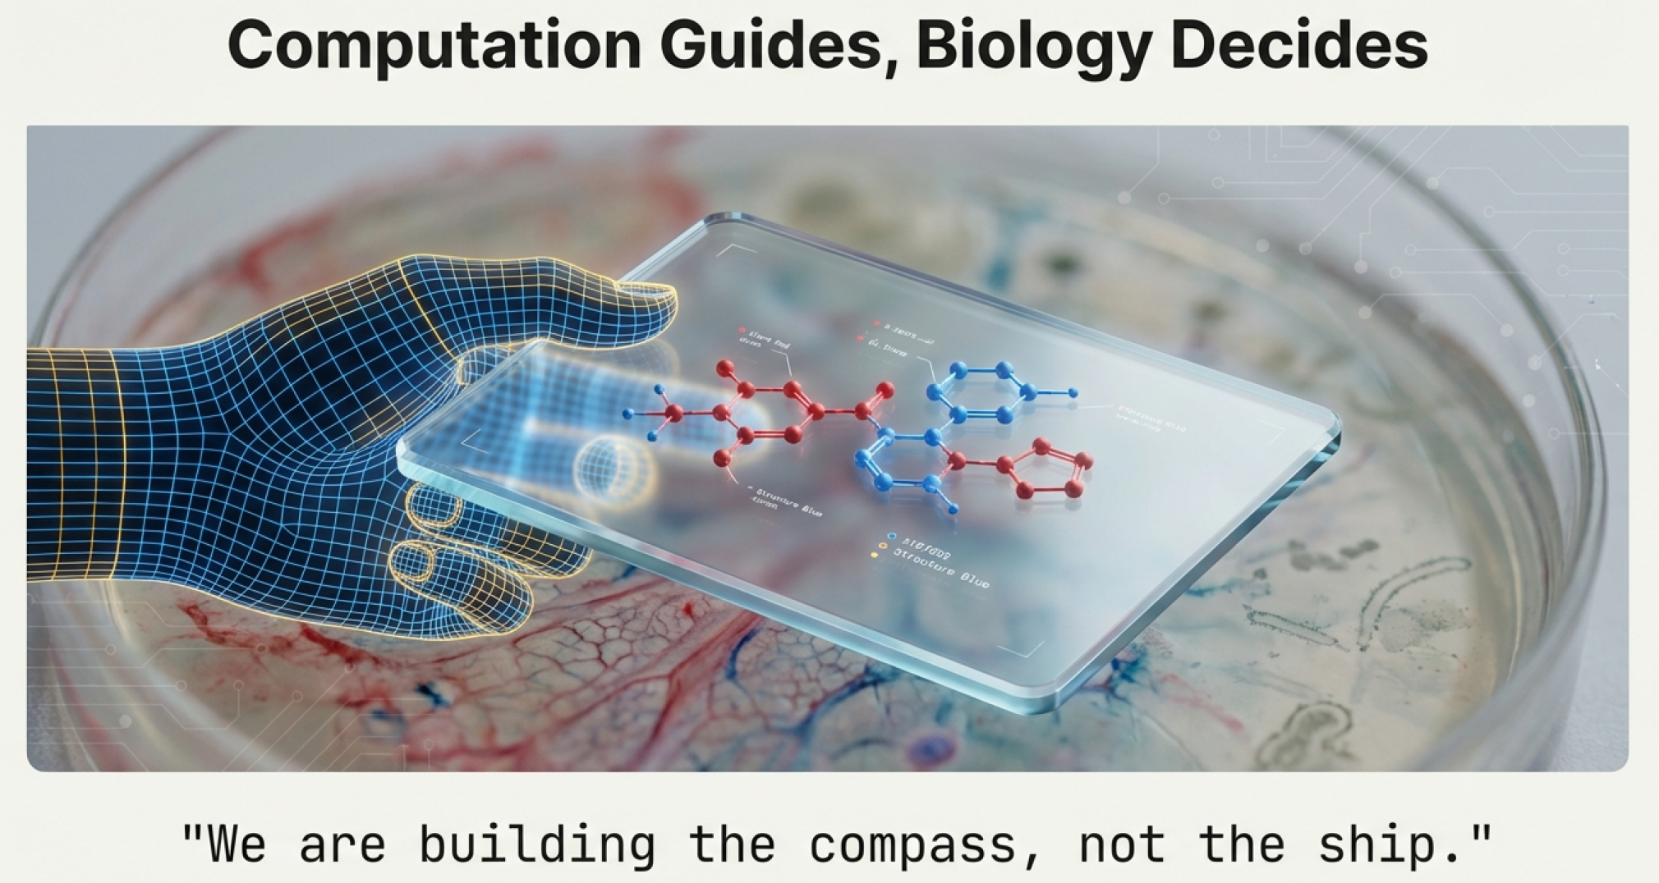
COMPUTATION VS BIOLOGY

